Slide 1
Customer Convert Prediction Use Case
By qi wen（Vicky）
Notes:
This qi wen from uoft and I am here to present my work process and story towards the cu

Slide 2
Executive Summary
Goal-- Build a model to make prediction on whether a user is going to convert or not, to include or exclude them from marketing campaigns
Process – Applied machine learning techniques to build a classification model
Result– Model accuracy is 94% and macro average for f1 score is 64%, the final model could capture 98% the potential buyers
Notes:
Brief summary for my work.

Slide 3
Agenda
Exploratory Data Analysis
Feature Engineering
Feature Selection
Initial Model Building
Model Improvement & Future Work
Business Insights & Application
Notes:
Brief summary for my work.

Slide 4
Exploratory Data Analysis

Slide 5




Insights from Custom Features on Data
US
May
Chrome
Desktop
Country with the largest # of records
Month (in first half of a year) with the largest # Transaction Records
Browser with the largest # records
Device with
the largest # records
49.8%
4.41
3.77
138s
bounce session ratio
Average hits
Average page views
Average time on site
Notes:
time series plot, week of year plot

Slide 6
Dataset Summary & Data Cleansing
Dataset(Google Merchandise Store): 392892 rows, 15 columns
Check Missing Values
Variables(Integer) | # Missing
Bounces | 196928
Pageviews | 36
Time On Site | 196493
Transaction Revenue | 387615
Transactions | 387615
Filled with 0
Notes:
Given the dataset about google merchandise store tracking information, first beginning with understand variable meaning and checking the data structure. The dataset contain nearly 4 hundred thousands of records. Except for the visitor ID, there are basically two datatypes for variables, (numerical)integer and categorical. The blue tables in the left shows the missing values for the numerical variable and the purple table shows the number of unique category , top category and its percentage for each categorical variable. We can see that most values for the city is missing, the variable city, country, source and browser contains many categories with low frequency, later in feature engineering stage we could consider incorporate some categories to reduce feature numbers.

Slide 7
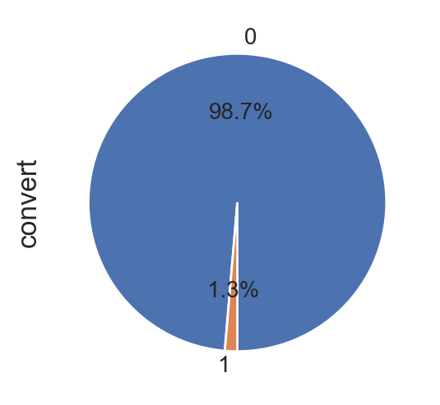
Label Creation
Convert: 0 for not convert, 1 for convert
Assumption: transaction/transaction value > 0, convert = 1
Imbalanced Class
Notes:
After data cleaning, I then start to create the result indicator for the case, whether or not the session get converted, in data moedling it is called label. Given the information I have for the dataset, I made a assumption that the conversion for this project is whether / not the transaction happened during the session. So the label is 0 and 1. …
I also made a pie chart– imbalanced classes

Slide 8
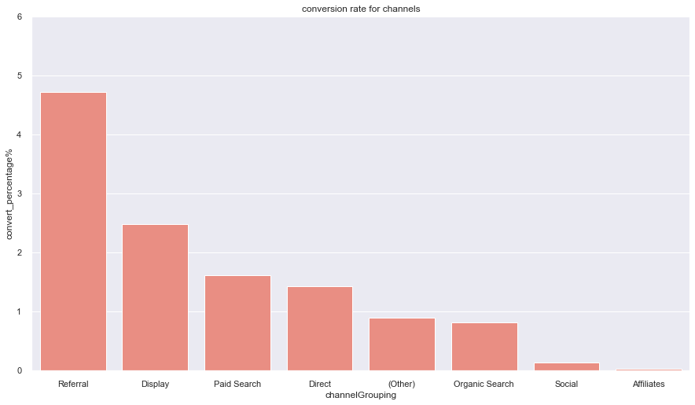
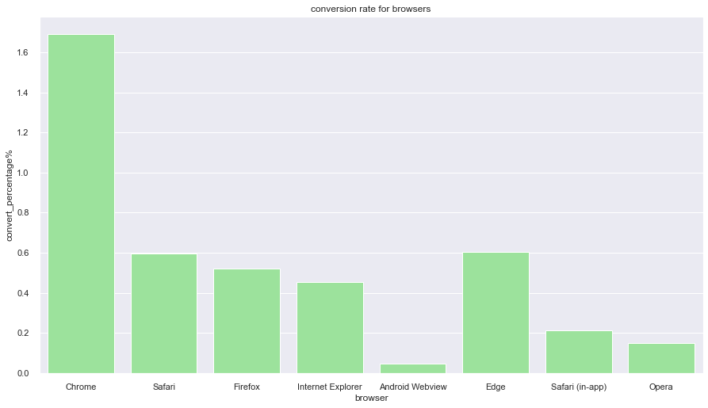
EDA-Browser & Channels
Convert percentage = # Convert / # Total Records within the Specific Category *100%
8 out of 39 browsers had positive convert rate
Chanel grouping referral had the highest convert rate in all browsers, especially chrome(92.38%)
Channels
Browser
Referral had the largest conversion rate
Chrome had the largest conversion rate
Notes:
Made some visualizations to gain insights for the features and inspiration for further feature engineering.
The conversion rates by channel metric helps you understand which channel is bringing the bulk of your traffic, whether that’s organic, paid, or social media. The more accurate you can be with this metric, the more you can reallocate ad spend accordingly to each respective channel.

Slide 9
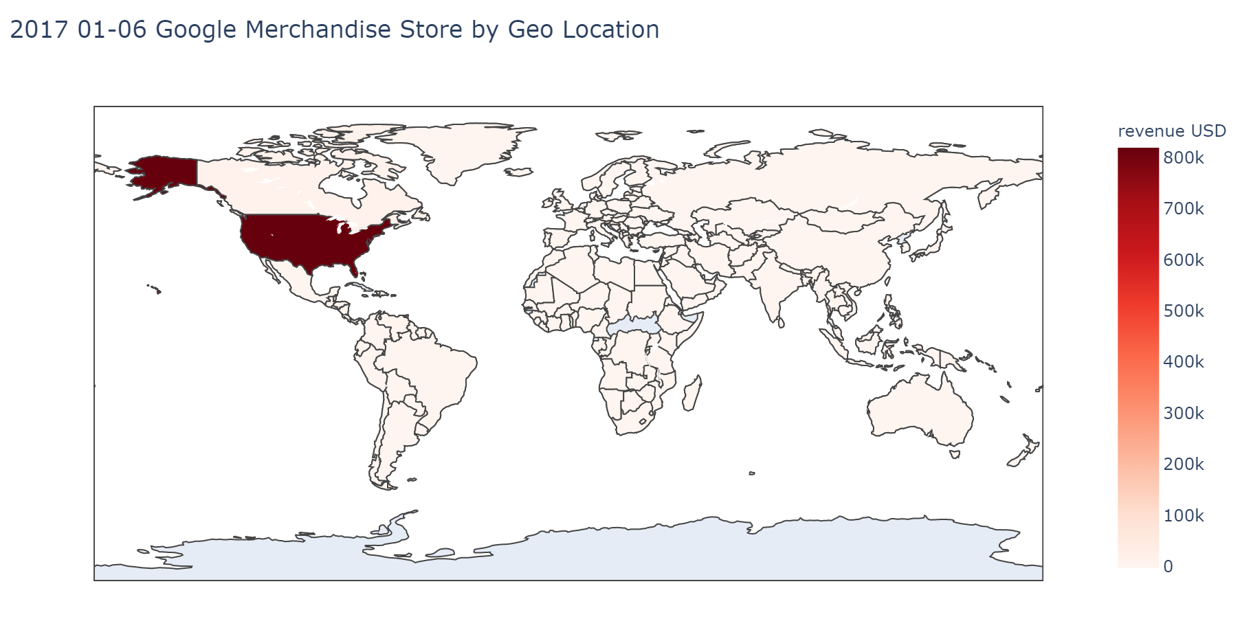
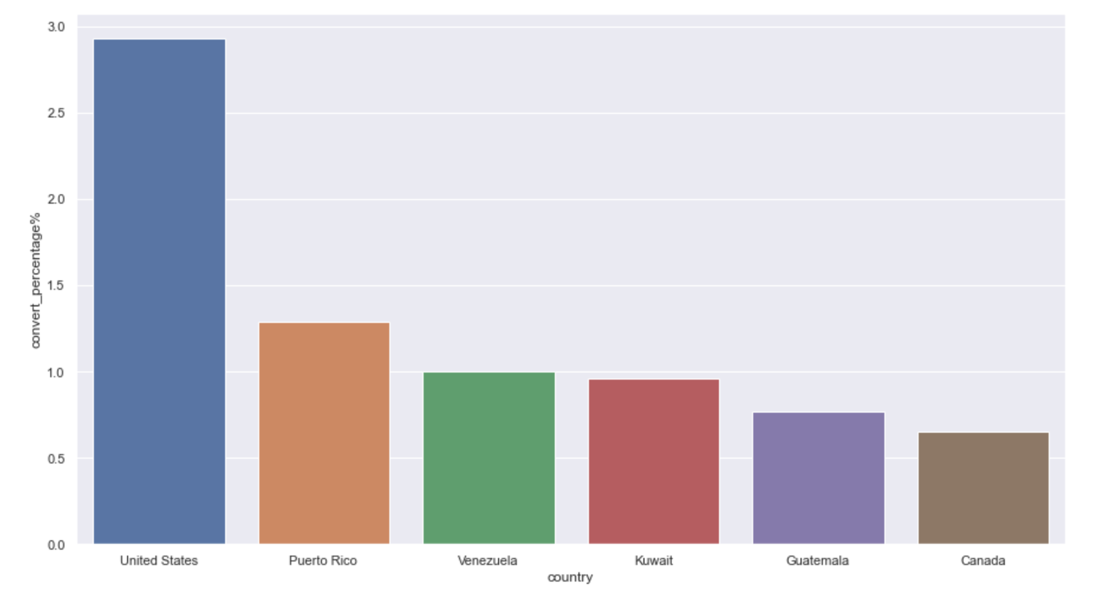
EDA- Country
The majority of revenue is generated from US-based transactions
US also had the largest conversion rate compared with other countries
Transaction Revenue for Different Countries
Conversion Rate for Countries

Slide 10
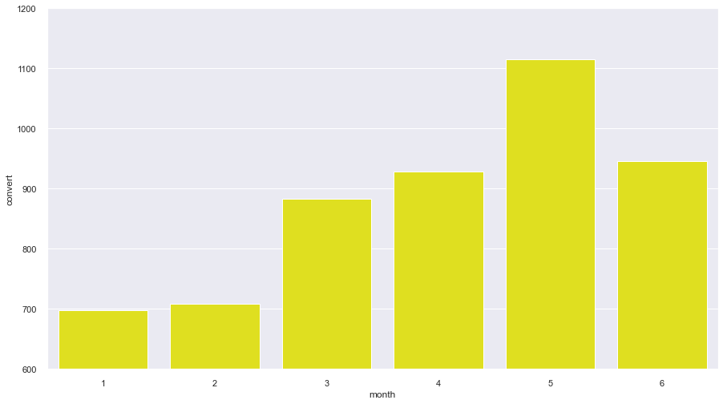
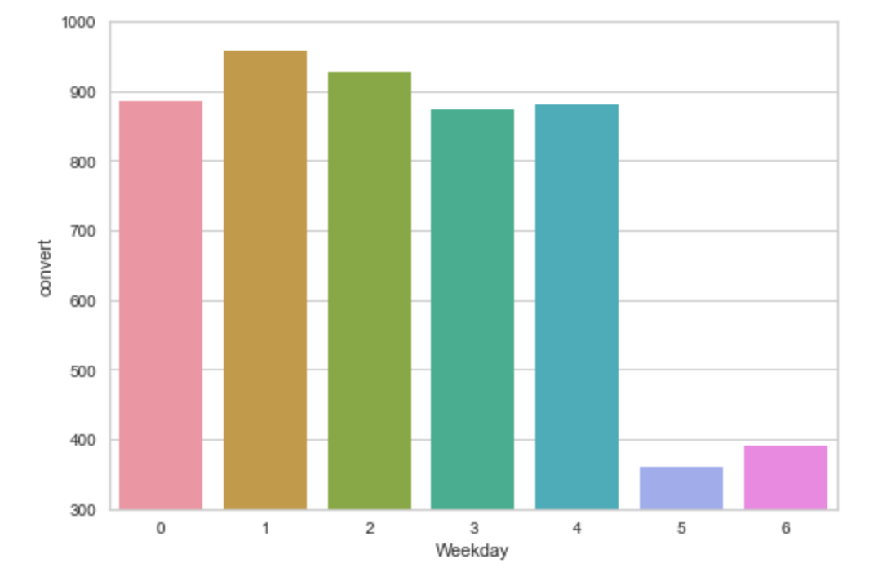
Data Visualization- Seasonality for Conversion
May had the largest # Convert Records
Transaction records #: Weekday > Weekend
# Conversion for the 6 months
weekend
Notes:
加图 time series plot, week of year plot

Slide 11
Feature Engineering

Slide 12
Feature Creation& Regrouping
Time-Related Features
Re-grouping
Date
Day
Month
Week of Year
Weekday
Variable(Categorical) | # Unique Category | Top Categories | Percentage (top category)
Source | 210 | direct | 42.6%
Channel Grouping | 8 | Organic Search | 49.7%
Browser | 39 | Chrome | 71.1%
Device Category | 3 | Desktop | 68.1%
Country | 213 | US | 43.8%
City | 416 | Not Available | 58.0%
Feature Deletion
City & Source
Contain Many Low Frequency Categories
Transaction & Transaction Revenue
Notes:
Since I had detect seasonality pattern during visualization in terms of conversion, I think time-related features might be important for model prediction
I also did a carefully check on all the categorical variable and found that some variable contain many low frequency categories that can be regrouped. I regrouped the variable country and browser and also decide to delete the variable city and source. I delete city because over 50% missing and many cities

Slide 13
Feature Summary
Categorical Features
Time-related Features
Day
Month
Regrouping Features
Country
Other
Weekday
Week of Year
Browser
North America
Other Countries
Top 8 Popular Browsers
Other browsers
Channel Grouping
Device Type
One-hot
Encoding
Numerical Features
Bounces
Page Views
Time on Site
Visit Number
Hits
90 Features
Notes:
After generation, regrouping and deletion of features, I then do one-hot encoding for all the cate features. Plus the numerical features I mentioned before, I had 90 features for model building

Slide 14
Feature Selection

Slide 15
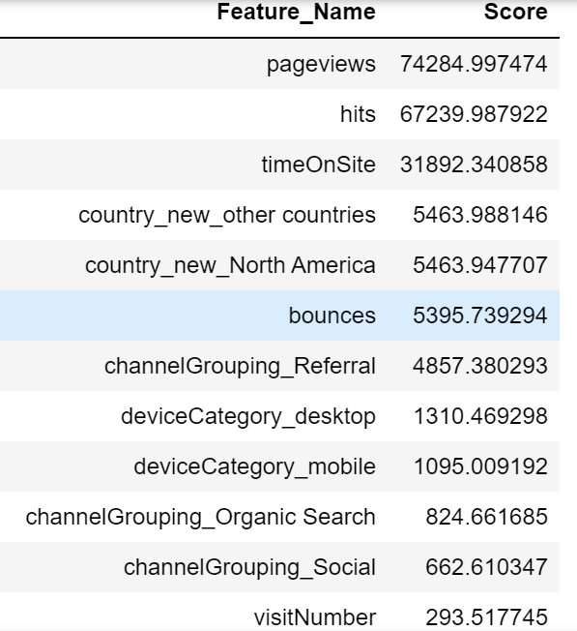
Feature Selection
Univariate Selection: Examines each feature individually to determine the strength of the relationship of the feature with the response variable
Use SelectKbest function in Python sklearn
to select top 40 features
The larger the score,
the more relevant between the feature and label

Slide 16
Initial Model Building

Slide 17
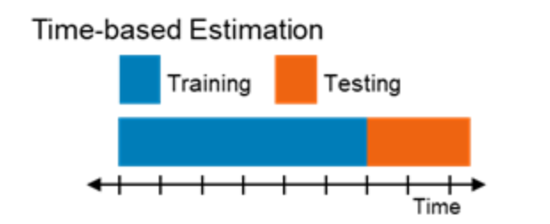
Train Test Split
Training Set: Data Records from date 2017/01/01 to 2017/05/24 【80%】
Test Set: Data Records after 2017/05/24 【20%】
Avoid Data Leakage
Notes:
Avoide data leakage

Slide 18
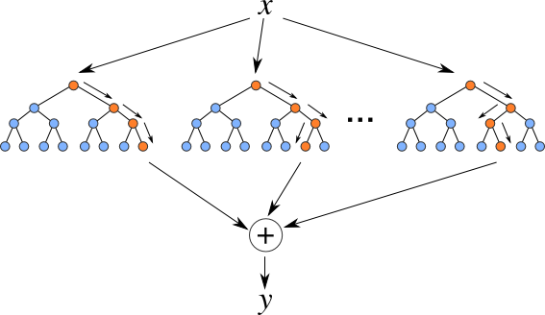
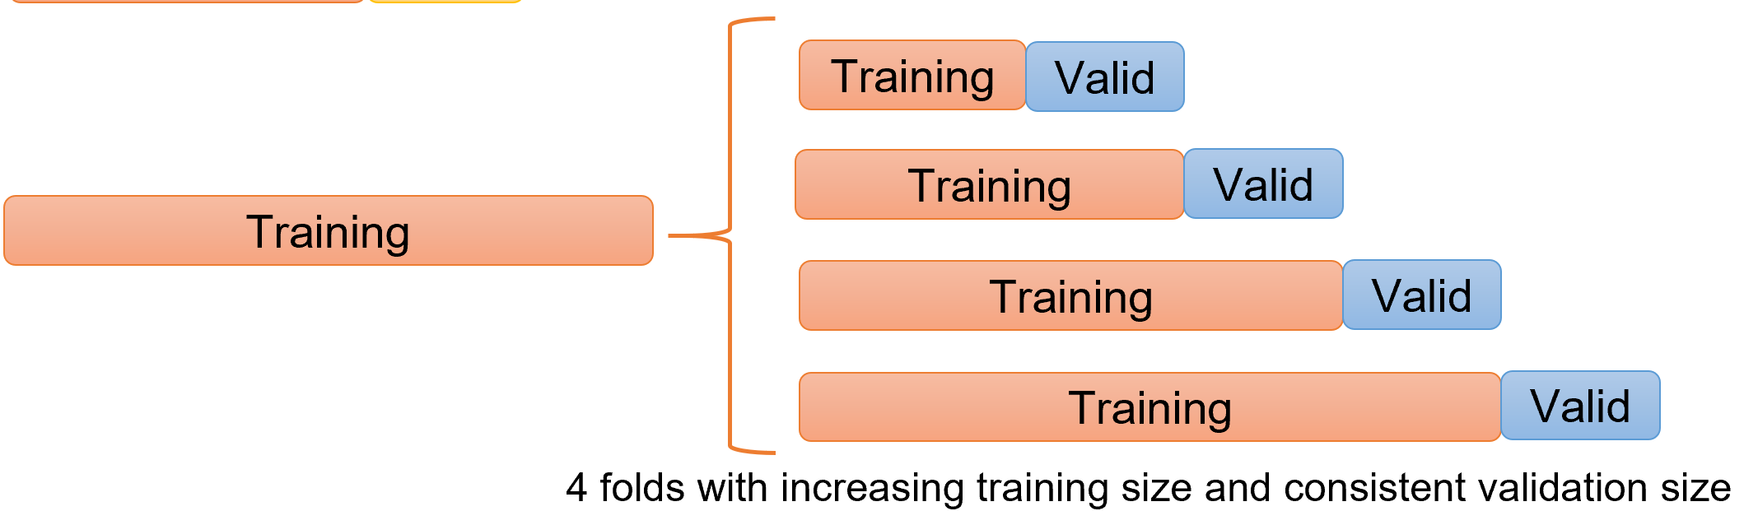
Model Selection & Hyperparameter Tuning
Random Forest:
Hyperparameter Tuning:
Handle overfitting
Relatively accurate without adjustment
Obtain Feature Importance
4-fold cross validation with time-series split
Max Depth, Max Num of subtrees
randomly select a set of input features
Notes:
Gain insights about which factor is crucial for make the prediction

Slide 19
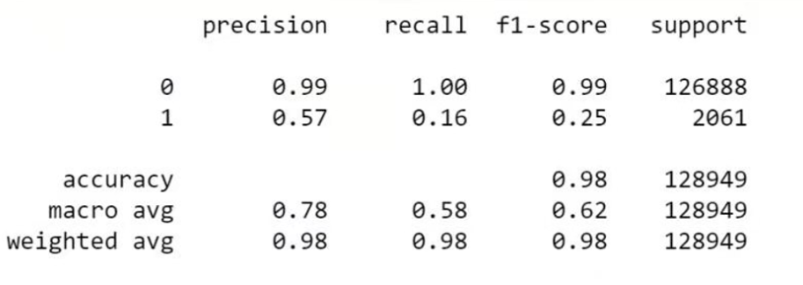
Initial Model Evaluation
Classification Report
Imbalanced Class
Model had weak performance on class 1 (convert)

Slide 20
Model Improvement & Future Work

Slide 21
Strategy 1: Resampling
Reason: Imbalanced Dataset
Over Sampling ： Increase # label 1 (convert) records in training set
Under Sampling：Reduce # label 0 (not convert) records in training set
Prediction on Convert Case is more important than not Convert Case
Less Records; Faster in Hyperparameter Tuning

Slide 22
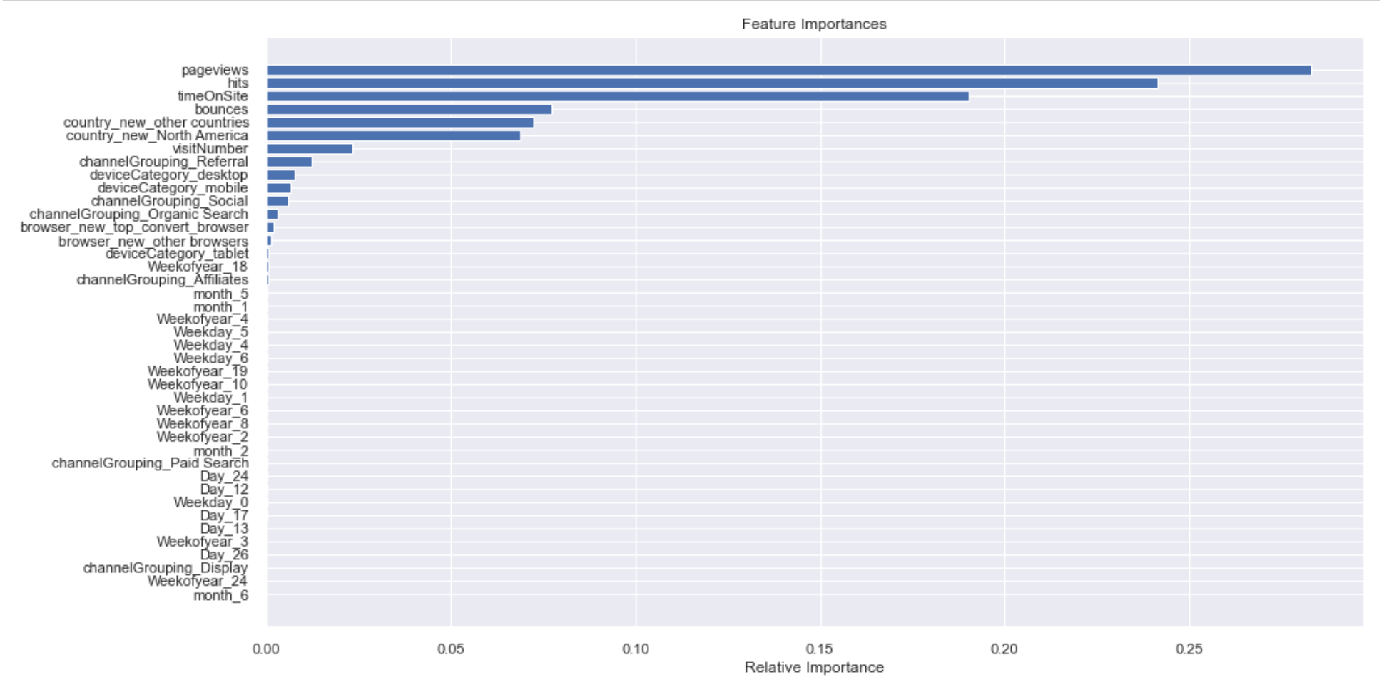
Strategy 2: Reduce Features
Feature Importance Plot from Random Forest
Many Unimportant Features involved in the model

Slide 23
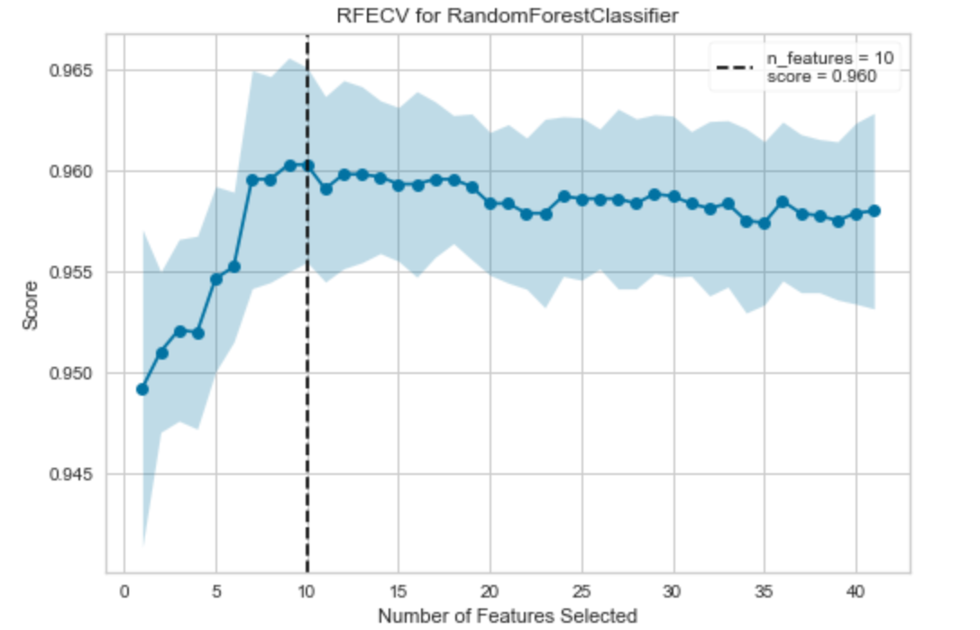
Strategy 2: Reduce Features (Contd)
Recursive Feature Elimination Curve
TOP 10 Features
Pageviews
Hits
Time on Site
Bounces
Country: Other Countries
Country: North_America
Visit Number
Channel: Referral
Device: Desktop
Device: Mobile
Reduce to
Model have best performance when # features = 10
Notes:
Optimal number of features, and the results shows that 10 feature would lead to best model performance
Elimate feature one by one, then recalculate the model accuracy

Slide 24
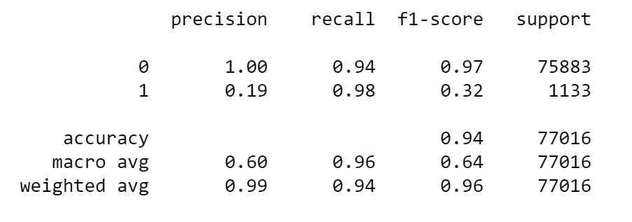
Improved Model Performance
Classification Report & Confusion Matrix
 | Prediction =0 | Prediction =1
Actual Label=0 | 70810 | 5073
Actual Label=1 | 16 | 1117
0.16
0.62
Class 1 Recall = #(actual & prediction =1) / # (actual =1) 1117/1117+16
Class 1 Precision = #(actual = 1) / #(prediction =1) 16+1117 / 5073+1117
Notes:
Recall gained huge improvement
Precision = TP/TP+FP-- of all records that labeled as convert, how many actually convert records? 5073+1117
Recall = TP/TP+FN--Of all the records that truly converted, how many did we label? 16+1117
F1 Score = 2*(Recall * Precision) / (Recall + Precision)

Slide 25
Future Model Work
More Data
More Powerful Models
Better Seasonality
Variables more relevant to Label
Other Ensemble Models: XGBOOST, Voting, Stacking
Built Customer-based Model
Clustering
Unique user ratio is about 70%
Notes:
With more data, we can have better view of seasonality, so the reason why I am mentioning that is this dataset only have 6-month seasonality, but we don’t know what the seasonality in December, chrismas, in summer, so with more data,we can have a better understanding on these seasonality features;
So with more data, we can build model on customer based model instead of session-based; in this model we treat each row as a single session and make prediction on each session, but with more data, we can understand what the customer buy before and how customer perform behavior before, make a prediction whether the customer would buy or not based on the history of the customer; applying clustering techniques to get more insight about the customer behavior;
built model on each individual customer
Have better view of seaonality, 6-month, we don’t know better understaind of seasonality features
Customer-based– treat ech row
Understand
Customer-basd model: general statistics + customer-specific feature – for each customer build a model or clustering , build model based on the cluster(I haven’t test yet, but I do think of potential direction);

Slide 26
Business Insights & Future Business Case

Slide 27
Business Insights
Capture All the Potential Buyers
High False Positive won’t Hurt
Promotion
Conduct Promotion to Model Labeled Convert Customer
Customer who had convert history(True Positive) – Buy More
Customer who don’t have convert history(False Positive) – may Start Conversion
Recall 98%--Almost all the Convert Records are Labelled Correctly by the Model
The Model also Labelled some not Convert Records as Convert
No Cost to Promote to these Customers since they are also Potential Buyers
Notes:
With recall equals to 98%, 98% of potential buyers would see and make purchase
False postivei—means it’s the prediction we wrongly predict some to be potential buyer, but in our case even though we had a very high false positive, it wouldn’t hurt if we want to do some promotion using our model because one of the reason is
If we want to do some promotion online, false positive would only result in additional promotion to more customers—no extra cost to do extra promotion

Slide 28

Future Business Case
Association Rule Learning on Potential Buyers
Customer who bought product X also bought product Y
Buddling Sales

Slide 29
Questions

Slide 30
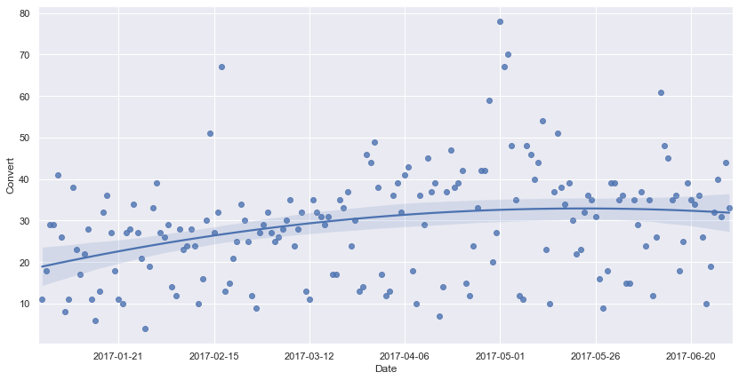
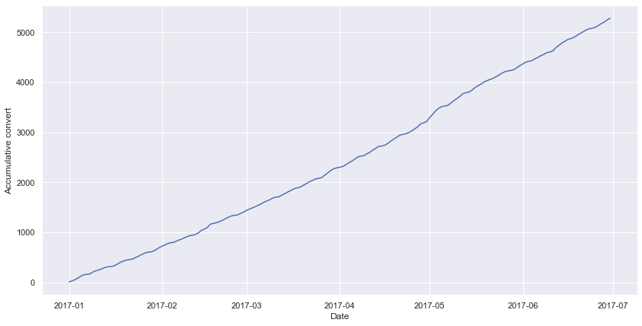
Appendix Plot
1

Slide 31
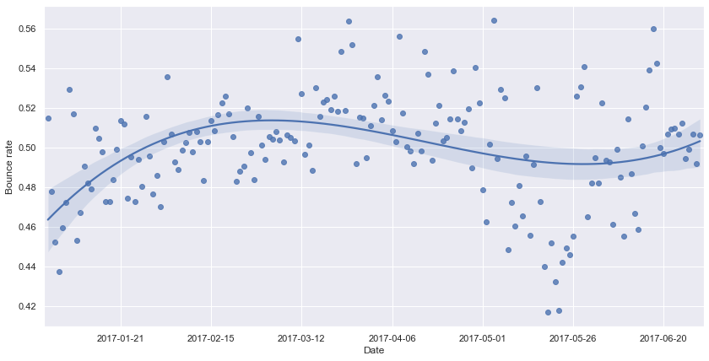
Appendix Plot
2
Notes:
137946

